Slide 1


Udajuicer:
Threat Report
YOUR NAME: Mohammed Alnajrani
8/31/2023

Slide 2
Purpose of this Report:
This is a threat model report for Udajuicer. The report will describe the threats facing Udajuicer. The model will cover the following:
Threat Assessment
Scoping out Asset Inventory
Architecture Audit
Threat Model Diagram
Threats to the Organization
Identifying Threat Actors
Vulnerability Analysis
Risk Analysis
Mitigation Plan
Remove this slide

Slide 3
Section 1
Threat Assessment

Slide 4
1.1: Asset Inventory
Components and Functions
Web server: is used to respond to client requests made over the World Wide Web. And the main job of it is to display website content to users by storing, processing, and delivering data
Application server: is used to deliver a dynamic, customized response to a client’s requests
Database: is used to create, edit, and maintain database files and records

Slide 5
1.2 Architecture Audit
Flaws
Lack of Demilitarized Zone (DMZ)
A firewall has not been used
Lack of Content Delivery Network (CDN)
Lack of Web Application Firewall (WAF)
Load Balancing is not been used

Slide 6
1.3 Threat Model Diagram
Using OWASP Threat Dragon, build a diagram showing the flow of data in the Juice Shop application and identify 3 possible threats to the Juice Shop. Make sure to include the following components:
Client
Web Server
Application Server
Database

Slide 7
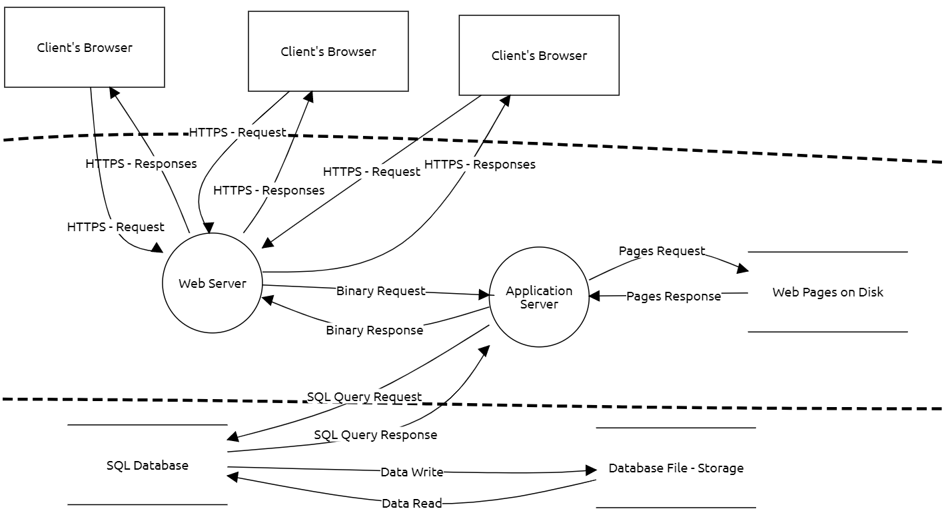
1.3 Threat Model Diagram
Insert the threat Model Diagram Here:
Identified threats:
SQL Injection
Cross Site Scripting (XSS)
Broken Authentication

Slide 8
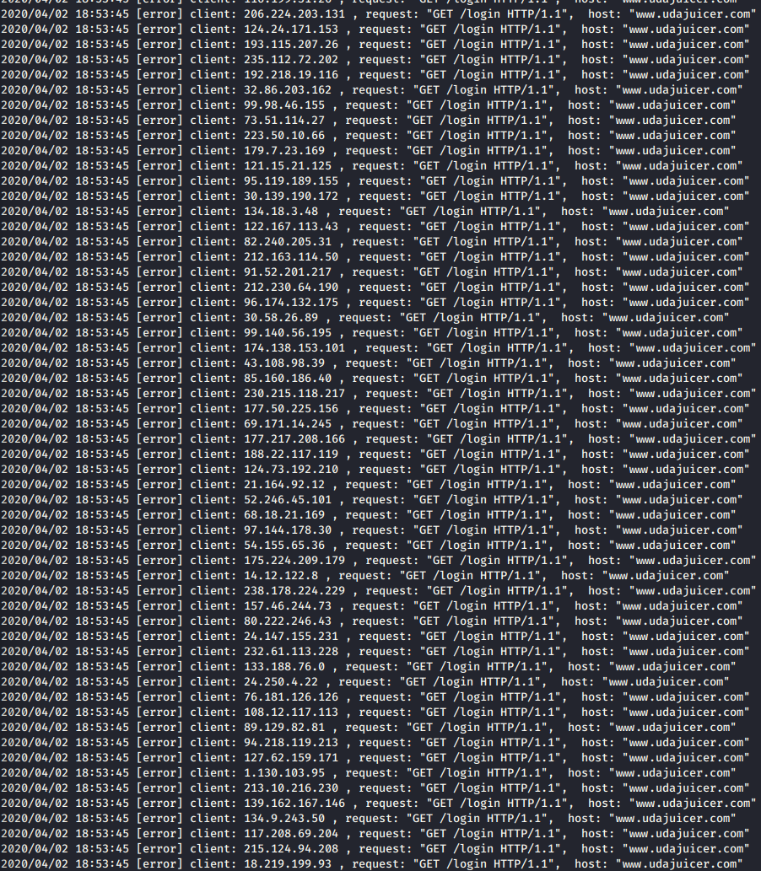
1.4 Threat Analysis
What Type of Attack Caused the Crash?
Denial of Service (DoS)
What in the Logs Proves Your Theory?
There are huge amounts of requests sent at the same time from different IPs to overwhelming the site and causing it to crash

Slide 9
1.5 Threat Actor Analysis
Who is the Most Likely Threat Actor?
Script Kiddies
What Proves Your Theory?
At first glance, it comes to mind that the threat actor responsible for the attack is Hacktivists, but Since the attack does not carry any political motives or ideological goals, because the attack targeted a site that sells juices, which is not related to any political or ideological goals. So, the threat actor should be Script Kiddies which are amateur attackers but there are prebuilt scripts that help in DoS attacks, and they use prebuilt scripts to perform this attack.

Slide 10
Section 2
Vulnerability Analysis

Slide 11
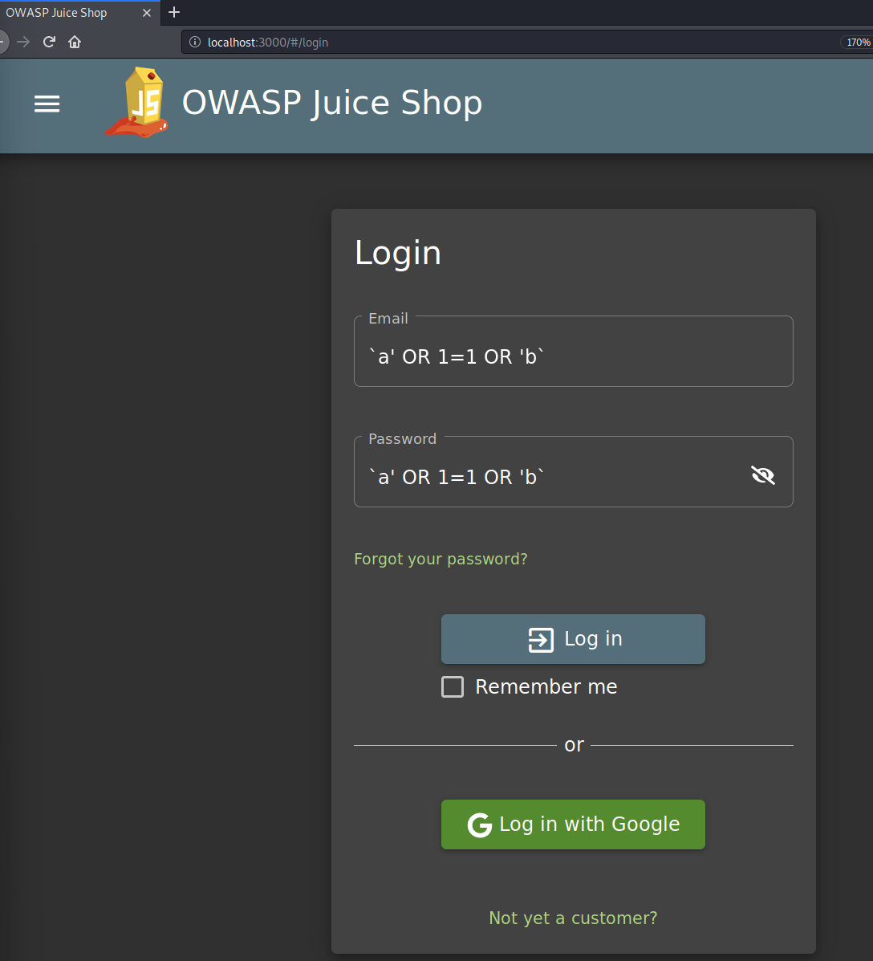
2.1 SQL Injection
Insert Screenshot of Your Commands Here:

Slide 12
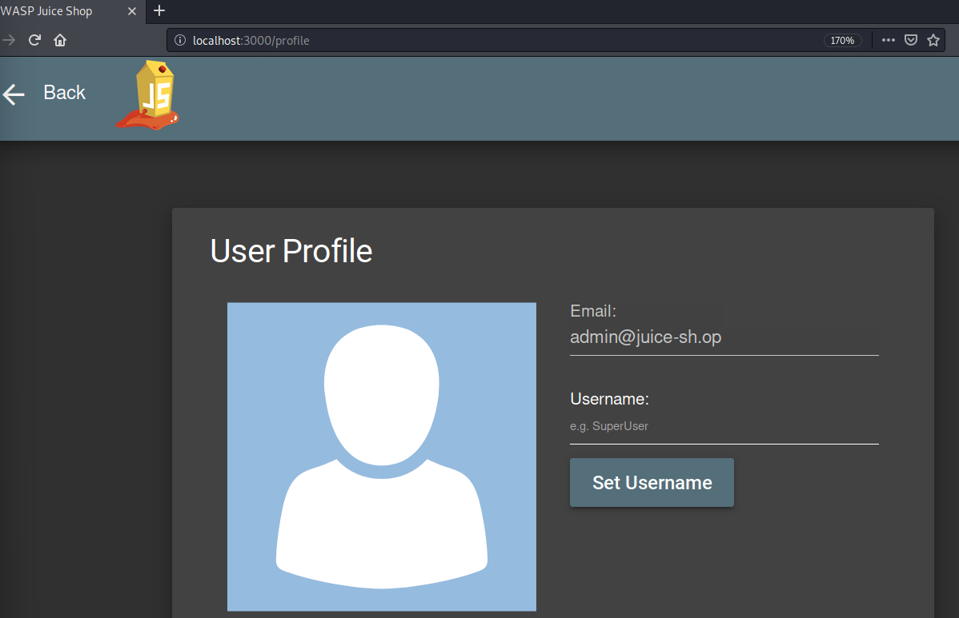
2.1 SQL Injection
Insert Screenshot of Account Settings Showing You as Admin Here:

Slide 13
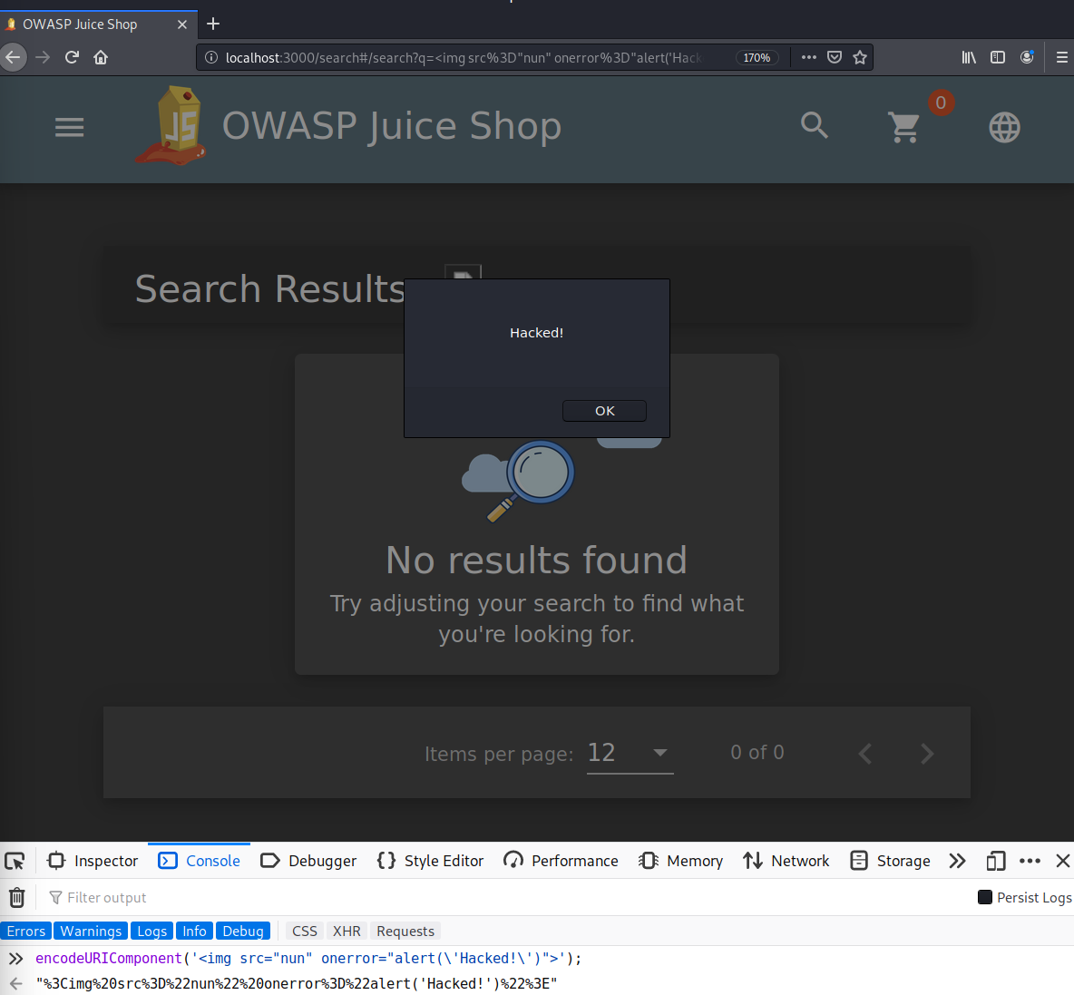
2.2 XSS
Insert Screenshot of Your Commands Here:

Slide 14
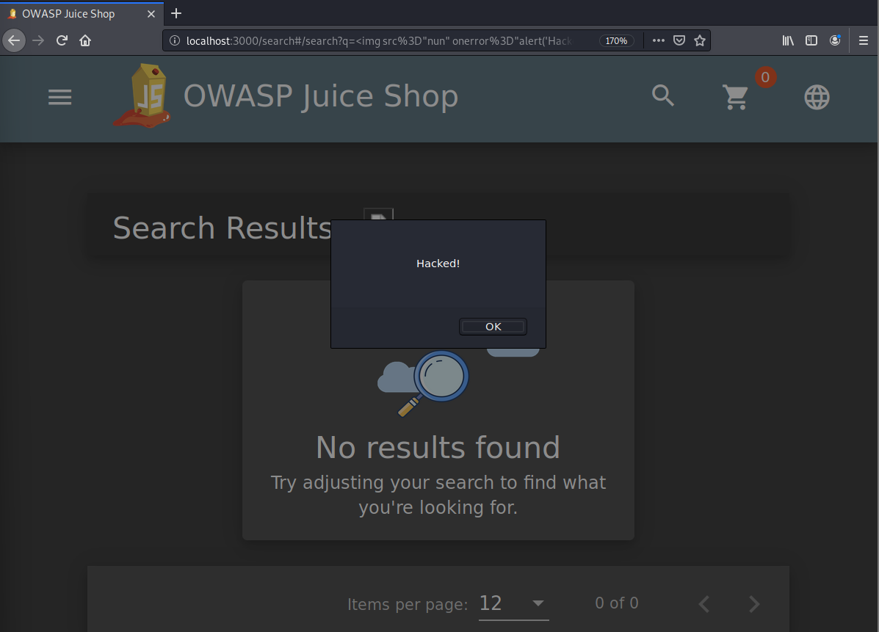
2.2 XSS
Insert Screenshot of alert() popup saying "Hacked!" Here:

Slide 15
Optional Task:
Extra Vulnerabilities
Insecure Design
Sensitive Data Exposure
Cryptographic Failures

Slide 16
Section 3
Risk Analysis

Slide 17
3.1 Scoring Risks
Risk | Score (1 is most dangerous, 4 is least dangerous)
Denial of Service (DoS) | 1
Insecure Architecture | 2
SQL Injection | 1
XSS Vulnerability | 3
Remove this slide

Slide 18
3.2 Risk Rationale
Why Did You Choose That Ranking?
Denial of Service (DoS) Score is 1 because an amateur hacker may do it and making a resource unavailable has a strong impact in terms of reputational and financial loss.
Insecure Architecture Score is 2 since it may lead to other attacks such as DoS, SQL injection, and data breach.
SQL Injection Score is 1 because it causes severe damage to the company’s reputation by leaking data or spoofing identity and tampering with existing data.
XSS Vulnerability The score is 3 because it is easy to avoid by either users or website owners and needs a professional hacker.

Slide 19
Section 4
Mitigation Plan

Slide 20
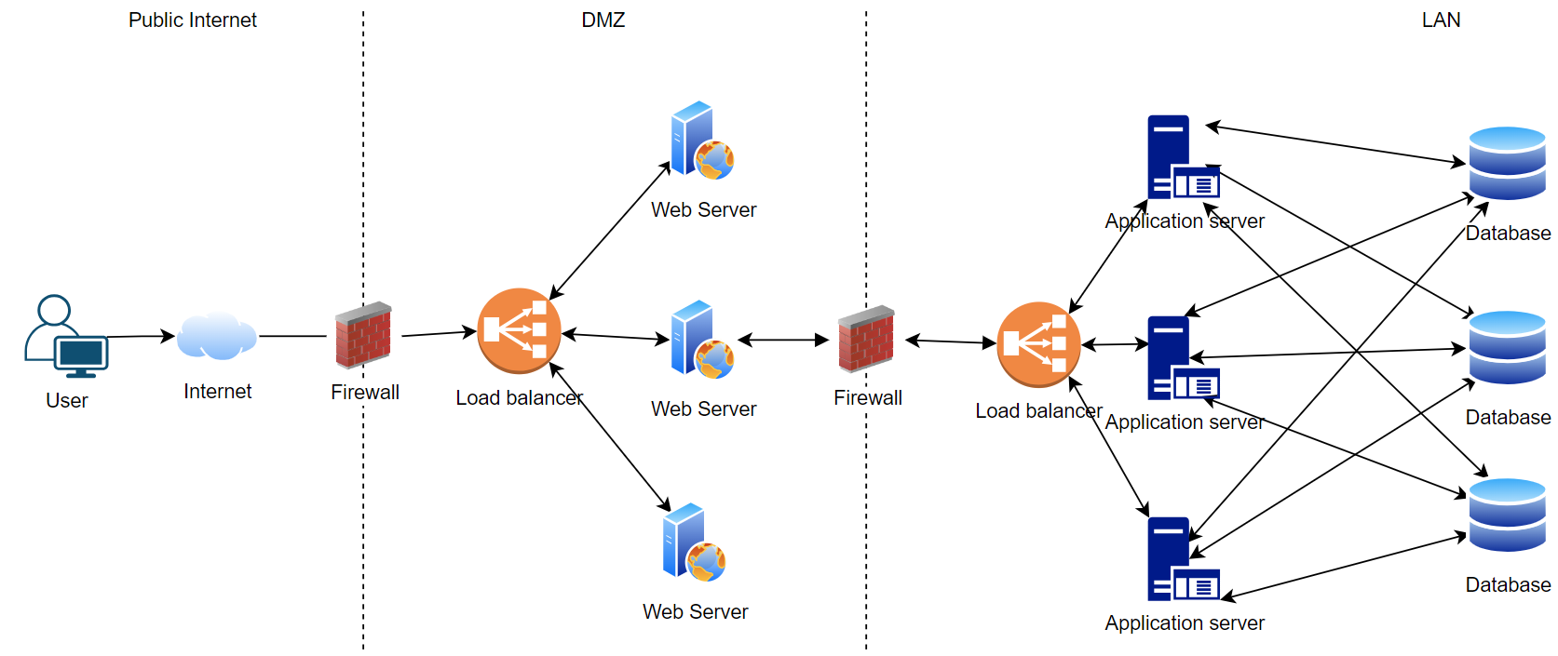
4.1 Secure Architecture
Insert Image of Your Secure Architecture Here:

Slide 21
4.2 Mystery Attack Mitigation
What is Your Mitigation Plan?
We can mitigate Denial of service (DoS) by implementing a secure architecture by using
Content Delivery Network (CDN) which provides a group of edge servers that serve cached content from the origin.
Load balancers to distribute incoming traffic evenly from client devices to servers
Firewalls to filter requests upstream long before they reach the target network.
Network segmentation technic to mitigate the attack.

Slide 22
4.3 SQL Injection Mitigation
What is Your Mitigation Plan?
We can mitigate SQL Injection attacks by using
Input Sanitization to clean user input,
Input Validation to match user input against expected input,
Use Prepared Statements with Parameterized Queries which will be waiting for parameters in the form of user input.
Escaping process which will convert characters in code, so they don't get interpreted.

Slide 23
4.4 XSS Mitigation
What is Your Mitigation Plan?
We can mitigate XSS attacks by using
Input Sanitization to clean user input,
Input Validation to match user input against expected input
Escaping process which will convert characters in code, so they don't get interpreted.

